Slide 1


Generative AI on AWS
Thuan Phat
Software Engineer@Katalon
© Amazon Web Services, Inc. or its Affiliates.
© Amazon Web Services, Inc. or its Affiliates.

Slide 2

Agenda
What is Generative AI?
Use Cases
How is the future of GenAI ?
How to get started?
2
Notes:
Agenda của chúng ta:
- Xem lại GenAI là gì
- Một số serverless patters for Generative AI
- Use case: Hyper- personalization
- Cuối cùng một số tài liệu mọi người tham khảo
2

Slide 3











What is Generative AI?
© 2023, Amazon Web Services, Inc. or its affiliates.
3
Notes:
Chúng ta cùng nhìn lại GenAI là gì
3

Slide 4
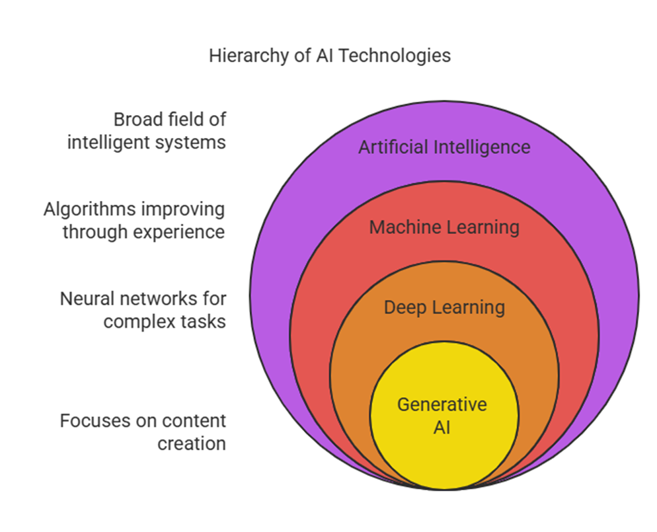
What is generative AI?
Notes:
Question: We have seen an increased interest in generative AI, but what exactly is generative AI?
But its not really new. AWS has been doing generative AI for years. For example, FMs are used to generate highly accurate search results on Amazon.com and to deliver the human-like conversational experience millions of people enjoy every day with Alexa. AND Amazon made the state-of-the-art Alexa Teacher Model (AlexaTM), a large language model (LLM) available through Amazon SageMaker. Customers can use this LLM for a wide range of use cases, from summarizing financial reports to powering human-like customer service chatbots.
Generative AI is on the rise because it can produce new original content that is close enough to human generated content for real-world tasks such as question answering, text summarization, and image generation.
The ML models powering generative AI, popularly known as foundation models or large language models (LLM), are trained on massive amounts of data with several hundred billion parameters (which is a measure of the sophistication of the model).
There are many existing successful applications that rely on LLMs, for example: AI21’s WordTune write which millions write more easily using AI21’s Jurassic model, ChatGPT which utilizes a customized version of OpenAI’s GPT3.5, Amazon CodeWhisperer that Accelerate application development with automatic code recommendations based on the code and comments in your IDE, which uses an AmazonLLM that trained on a code dataset . We now see many enterprise customers that want to harness the same foundation models to their business use cases.
Developers can adapt the models for a wide range of use cases, with little fine-tuning required for each task. For example, Stable Diffusion, the foundation model from Stability AI is used by hundreds of applications such as DreamStudio, and Photoshop reaching millions of end users. In this way, the power of these capabilities is accessible to all, including developers who lack specialized machine learning skills and, in some cases, people with no technical background. Using foundation models can also reduce the time for developing new AI applications to a level rarely possible before
GenAI không
4

Slide 5

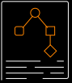



What is generative AI?
AI that can produce original content close enough to human generated content for real-world tasks
Powered by foundation models pre-trained on large sets of data with several hundred billion parameters
Tasks can be customized for specific domains with minimal fine-tuning
Applicable to many use cases like text summarization, question answering, digital art creation, code generation, etc.
Reduces time and cost to develop ML models and innovate faster
Notes:
Question: We have seen an increased interest in generative AI, but what exactly is generative AI?
But its not really new. AWS has been doing generative AI for years. For example, FMs are used to generate highly accurate search results on Amazon.com and to deliver the human-like conversational experience millions of people enjoy every day with Alexa. AND Amazon made the state-of-the-art Alexa Teacher Model (AlexaTM), a large language model (LLM) available through Amazon SageMaker. Customers can use this LLM for a wide range of use cases, from summarizing financial reports to powering human-like customer service chatbots.
Generative AI is on the rise because it can produce new original content that is close enough to human generated content for real-world tasks such as question answering, text summarization, and image generation.
The ML models powering generative AI, popularly known as foundation models or large language models (LLM), are trained on massive amounts of data with several hundred billion parameters (which is a measure of the sophistication of the model).
There are many existing successful applications that rely on LLMs, for example: AI21’s WordTune write which millions write more easily using AI21’s Jurassic model, ChatGPT which utilizes a customized version of OpenAI’s GPT3.5, Amazon CodeWhisperer that Accelerate application development with automatic code recommendations based on the code and comments in your IDE, which uses an AmazonLLM that trained on a code dataset . We now see many enterprise customers that want to harness the same foundation models to their business use cases.
Developers can adapt the models for a wide range of use cases, with little fine-tuning required for each task. For example, Stable Diffusion, the foundation model from Stability AI is used by hundreds of applications such as DreamStudio, and Photoshop reaching millions of end users. In this way, the power of these capabilities is accessible to all, including developers who lack specialized machine learning skills and, in some cases, people with no technical background. Using foundation models can also reduce the time for developing new AI applications to a level rarely possible before
GenAI không
4

Slide 6

Why foundation models?
Tasks
Tasks
Labeled data
…
Text generation
Text generation
Labeled data
…
Summarization
Summarization
Unlabeled data
FM
Labeled data
ML models
Information extraction
Information extraction
Labeled data
…
Q&A
Q&A
Labeled data
…
Chatbot
Chatbot
Train
Deploy
Pretrain
Adapt
Traditional ML models
Foundation models
6
Notes:
The size and general-purpose nature of FMs make them different from traditional ML models, which typically perform specific tasks, like analyzing text for sentiment, classifying images, and forecasting trends.
With tradition ML models, in order to achieve each specific task, customers need to gather labeled data, train a model and deploy that model. With foundation models, instead of gathering labeled data for each model and training multiple models, customers can use the same pretrained FM to adapt various tasks. FMs can also be customized to perform domain-specific functions that are differentiating to their businesses, using only a small fraction of the data and compute required to train a model from scratch.
Transition-> The potential of FMs is incredibly exciting. But, we are still in the very early days. While ChatGPT has been the first broad generative AI experience to catch customers’ attention, most folks studying generative AI have quickly come to realize that several companies have been working on FMs for years, and there are several different FMs available—each with unique strengths and characteristics. As we’ve seen over the years with fast-moving technologies, and in the evolution of ML, things change rapidly. We expect new architectures to arise in the future, and this diversity of FMs will set off a wave of innovation. We’re already seeing new application experiences never seen before.
[Additional talking points]
There are three reasons that explains foundational models success
The transformer architecture:, the transformer architecture is a type of neural network that is efficient, easy to scale and parallelize, and can model interdependence between input and output data.
In-context learning: Showing potential on a range of applications, from text classification to translation and summarization, this new training paradigm provides pre-trained models with instructions for new tasks or just a few examples instead of training or fine-tuning models on labeled data. Because no additional data or training is needed and prompts are provided in natural language, models can be applied right out of the box
Emergent Behaviors at Scale Growing model size and the use of increasingly large amounts of data have resulted in what is being termed as “emerging capabilities.” When models reach a critical size, they begin displaying capabilities not previously present.
(could also add:
The seeds of a machine learning (ML) paradigm shift have existed for decades, but with the ready availability of virtually infinite compute capacity, a massive proliferation of data, and the rapid advancement of ML technologies, customers across industries are transforming their businesses. Just recently, generative AI applications like ChatGPT have captured widespread attention and imagination. We are truly at an exciting inflection point in the widespread adoption of ML, and we believe most customer experiences and applications will be reinvented with generative AI.)
6

Slide 7
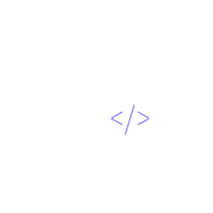
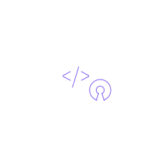

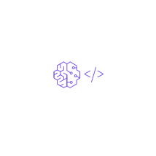


Building generative AI applications is challenging
Accessing
multiple FMs
and newer versions
Customizing
FMs is not easy
Data privacy
and security
Getting FMs
to execute tasks
Connecting to
data sources
Difficult
to manage infrastructure
Notes:
Customers have told us there are a few big things standing in their way of using FMs more broadly.
First, there is no single model optimized for every task, and models are going to be constantly improved with newer advances in technology for the foreseeable future. So, for any particular use case, customers often need to put together several models that work with each other or upgrade the same model to newer versions. This can take time and resources.
Second, customers want it to be easy to take the base FM, and build differentiated apps using their own data.
And, since the data customers want to use for customization is incredibly valuable IP, they need it to stay completely protected, secure, and private during that process, and they want control over how their data is shared and used.
FMs on their own are limited because they cannot complete complex tasks that require them to interact with external systems and don’t have up-to-date knowledge sources, like inventory data for an ecommerce company. To make these kinds of capabilities possible, developers must go through a multistep process to accomplish even simple tasks, like booking a flight, filing an insurance claim, or returning a purchased item. This process includes providing specific definitions and instructions to the FM, configuring access to company data sources, and writing API code to execute take actions.
Lastly, customers want integration into applications to be seamless, without having to manage huge clusters of infrastructure or incur large costs.
7

Slide 8










Foundation Model on AWS
Amazon Bedrock Marketplace: offering over 100 models from third-party partners (such as DeepSeek...)

Slide 9









z
Pre-training
Fine-tuning
Unlocking the value of
Generative AI
PURPOSE
DATA NEED
PURPOSE
DATA NEED
Maximizing accuracy for
broad domain
Massive amounts of
unlabeled data
Maximizing accuracy
for specific tasks
Small number
of labeled examples
Generative AI is emerging across a range of domains …
Enhance customer experience
Boost employee productivity
Creativity and content creation
Improve business operations
CHATBOTS
VIRTUAL ASSISTANTS
CONVERSATIONAL SEARCH SUMMARIZATION CODE GENERATION DATA TO INSIGHTS
WRITING MEDIA DESIGN MODELING
DOCUMENT PROCESSING
PROCESS OPTIMIZATION CYBERSECURITY DATA AUGMENTATION
AI-POWERED CONTACT CENTER PERSONALIZATION
Notes:
The potential of Generative AI is incredibly exciting with a forecasted $7T increase in global GDP over the next 10 years. Let’s have a look at common use cases that AI and Generative AI, enable. You can apply generative AI across all liniklmo[[es of business including engineering, marketing, customer service, finance, and sales.
You can use generative AI to improve customer experience through capabilities such as chatbots, virtual assistants, intelligent contact centers, personalization, and content moderation.
You can boost your employees’ productivity with generative AI powered conversational search, content creation, text summarization, and code generation among others.
You can use generative AI to turbocharge production of all types of creative content from art and music to and text, images, animations and video.
Finally, you can use generative AI to improve business operations with intelligent document processing, maintenance assistants, quality control and visual inspection, and synthetic training data generation.

Slide 10






Chatbots
Conversational search
Text, image,
Document processing
video generation
Virtual Assistants
Agent Assist
Product design
Content moderation
Post-call analytics
Content Creation
Music creation
Data augmentation
Personalization
Code generation
Media enhancement
Predictive maintenance
Creating animations
Quality control
Identity Verification
Text summarization
Modeling
Fraud detection
Sales scripts
Enhance customer
Boost employee
Creativity & Content
Improve business
experience
productivity
Creation
operations
Notes:
Customers have told us there are a few big things standing in their way of using FMs more broadly.
First, there is no single model optimized for every task, and models are going to be constantly improved with newer advances in technology for the foreseeable future. So, for any particular use case, customers often need to put together several models that work with each other or upgrade the same model to newer versions. This can take time and resources.
Second, customers want it to be easy to take the base FM, and build differentiated apps using their own data.
And, since the data customers want to use for customization is incredibly valuable IP, they need it to stay completely protected, secure, and private during that process, and they want control over how their data is shared and used.
FMs on their own are limited because they cannot complete complex tasks that require them to interact with external systems and don’t have up-to-date knowledge sources, like inventory data for an ecommerce company. To make these kinds of capabilities possible, developers must go through a multistep process to accomplish even simple tasks, like booking a flight, filing an insurance claim, or returning a purchased item. This process includes providing specific definitions and instructions to the FM, configuring access to company data sources, and writing API code to execute take actions.
Lastly, customers want integration into applications to be seamless, without having to manage huge clusters of infrastructure or incur large costs.
7

Slide 11


Protein folding
Design parts
Risk management
Product review
Video game
summaries
generation
Drug
Media content
Material design
Fraud detection
Chatbots
design
improvement
Personalized
Predictive
Customer
Optimize pricing
Face synthesis
medicine
maintenance
segmentation
and inventory
Improve medical
Product
Synthetic data
Next best action
Film
imaging
descriptions
preservation
Ambient digital
Chip design
Credit scoring
Fraud detection
Video generation
scribes
Healthcare & Life Sciences
Industrial & manufacturing
Financial services
Retail
Media & entertainment
Notes:
Customers have told us there are a few big things standing in their way of using FMs more broadly.
First, there is no single model optimized for every task, and models are going to be constantly improved with newer advances in technology for the foreseeable future. So, for any particular use case, customers often need to put together several models that work with each other or upgrade the same model to newer versions. This can take time and resources.
Second, customers want it to be easy to take the base FM, and build differentiated apps using their own data.
And, since the data customers want to use for customization is incredibly valuable IP, they need it to stay completely protected, secure, and private during that process, and they want control over how their data is shared and used.
FMs on their own are limited because they cannot complete complex tasks that require them to interact with external systems and don’t have up-to-date knowledge sources, like inventory data for an ecommerce company. To make these kinds of capabilities possible, developers must go through a multistep process to accomplish even simple tasks, like booking a flight, filing an insurance claim, or returning a purchased item. This process includes providing specific definitions and instructions to the FM, configuring access to company data sources, and writing API code to execute take actions.
Lastly, customers want integration into applications to be seamless, without having to manage huge clusters of infrastructure or incur large costs.
7

Slide 12

Generative AI Use Cases ?
Creativity & Content Creation Text, image, video generation

Slide 13



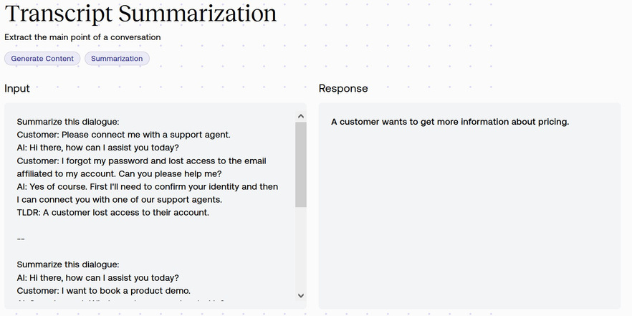
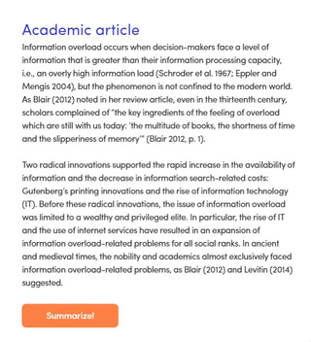


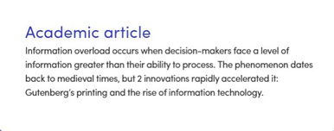
Text generation
Summarization
Reading assistance
Writing assistance
Applications include:
Applications include:
Applications include:
Point by point summaries Toxicity detection Comprehension e.g.,
translate legalese
• •
Rephrase lines of dialog and other written content Write short blogs, product
descriptions, news items,
emails etc.
• •
Summaries of scripts and other content Call center transcripts
• • •

Slide 14

Text generation use cases
Marketing
Product descriptions Marketing and sales copies Create an ad from a
product description
Create copy for a web page,
blog, or article
HR
Create job postings Help create interview questions
for candidate assessment
Education
Help create new teaching materials, essay prompts, quiz questions
Pharma
Create a report from clinical trial data
Financial Services
Real time market insights from financial market data
Legal
Summarization and translation of legal documents (e.g., contracts, patent applications)
Productivity
Compose emails Draft common documents Rewrite content for a
different audience
M&E
Video script generation Converting sports data into news

Slide 15






Image transformation & generation: overview
Image transformation
4x
Generated by Stable Diffusion 2.0
Upscaling

Slide 16
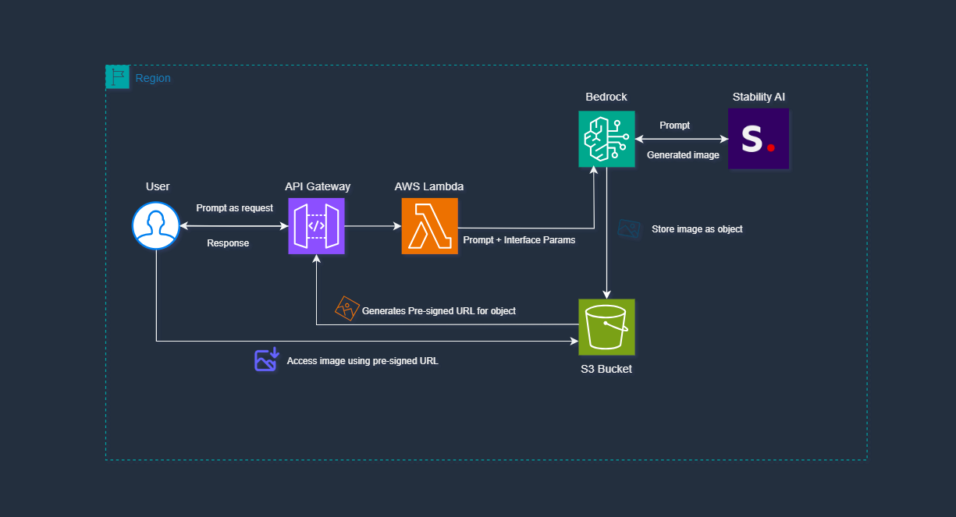
AWS Architecture
Notes:
The size and general-purpose nature of FMs make them different from traditional ML models, which typically perform specific tasks, like analyzing text for sentiment, classifying images, and forecasting trends.
With tradition ML models, in order to achieve each specific task, customers need to gather labeled data, train a model and deploy that model. With foundation models, instead of gathering labeled data for each model and training multiple models, customers can use the same pretrained FM to adapt various tasks. FMs can also be customized to perform domain-specific functions that are differentiating to their businesses, using only a small fraction of the data and compute required to train a model from scratch.
Transition-> The potential of FMs is incredibly exciting. But, we are still in the very early days. While ChatGPT has been the first broad generative AI experience to catch customers’ attention, most folks studying generative AI have quickly come to realize that several companies have been working on FMs for years, and there are several different FMs available—each with unique strengths and characteristics. As we’ve seen over the years with fast-moving technologies, and in the evolution of ML, things change rapidly. We expect new architectures to arise in the future, and this diversity of FMs will set off a wave of innovation. We’re already seeing new application experiences never seen before.
[Additional talking points]
There are three reasons that explains foundational models success
The transformer architecture:, the transformer architecture is a type of neural network that is efficient, easy to scale and parallelize, and can model interdependence between input and output data.
In-context learning: Showing potential on a range of applications, from text classification to translation and summarization, this new training paradigm provides pre-trained models with instructions for new tasks or just a few examples instead of training or fine-tuning models on labeled data. Because no additional data or training is needed and prompts are provided in natural language, models can be applied right out of the box
Emergent Behaviors at Scale Growing model size and the use of increasingly large amounts of data have resulted in what is being termed as “emerging capabilities.” When models reach a critical size, they begin displaying capabilities not previously present.
(could also add:
The seeds of a machine learning (ML) paradigm shift have existed for decades, but with the ready availability of virtually infinite compute capacity, a massive proliferation of data, and the rapid advancement of ML technologies, customers across industries are transforming their businesses. Just recently, generative AI applications like ChatGPT have captured widespread attention and imagination. We are truly at an exciting inflection point in the widespread adoption of ML, and we believe most customer experiences and applications will be reinvented with generative AI.)
6

Slide 17

Demo GenAI
Content Creative Use Case
Notes:
We would love to show you an E2E use case built on serverless.
33
Amazon Confidential

Slide 18


Emerging Serverless Patterns for Generative AI
© 2024, Amazon Web Services, Inc. or its affiliates. All rights reserved. Amazon Confidential and Trademark.
Notes:
Chúng ta cùng tìm hiểu cách implement các đặc điểm đó của ứng dụng AI thông qua Serverless Patterns trên nền tảng AWS
9
Amazon Confidential

Slide 19







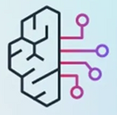











Patterns Emerging
Retrieval Augmented Generation (RAG)
Multi-modal
What is top
speed of the EQS?
Mercedes EQS is an electric vehicle with ….
Vector Embedding
Multiple Models
Agent
Action
Group
ANTHROP\C
Data
Prompt Template
Notes:
Retrieval Augmented Generation (RAG): is a technique to retrieve data from outside a foundation model to augment the prompts by injecting the relevant retrieved data into the context.
Document Summarization: Large language models (LLMs) can be used to analyze complex documents and provide summaries and answers to questions.
Document Generation: Document generation plays a crucial role in streamlining business operations and enhancing productivity. Whether you need to create contracts, reports, agreements, invoices, or any other important documents, harnessing the power of the document generation tool can revolutionize your workflow.
10

Slide 20


UPDATE this Presentation Header IN SLIDE MASTER
RAG
Improve the accuracy of foundational model response by augmenting the question with contextual information.
QUESTION
ANSWER
FOUNDATION
MODEL
RAG
Vector embeddings
© 2025, Amazon Web Services, Inc. or its affiliates. All rights reserved.
12
Notes:
However we need the model to provide answer that are highly relevant to my industry, my company’s policy, my products, etc. One commonly adopted technique to improve the accuracy of foundation model response is RAG – Retrieval augmented generation or knowledge retrieval. As the indicates, it is basically retrieving relevant knowledge from a data store and augmenting the prompt/question with that relevant information so that foundation model generates more accurate information based on the knowledge.
So the prompt that is sent to foundation model has at least two parts.
User’s questions
Context Augmentation.
The context comes from a external store typically a vector data store, a specialized data store where the information is stored as set of numbers and organized in a clever way. It places similar information close to each other.
These set of numbers are vector embeddings. These are generated by special type of FM called embedding model, These embedding model generate raw text data into easily queryable embeddings. These are then stored in the knowledge store. Lets see how serverless can help with this process.
Transit: next let’s take a look how RAG can be built into a serverless-based GenAI pattern step by step.
12

Slide 21
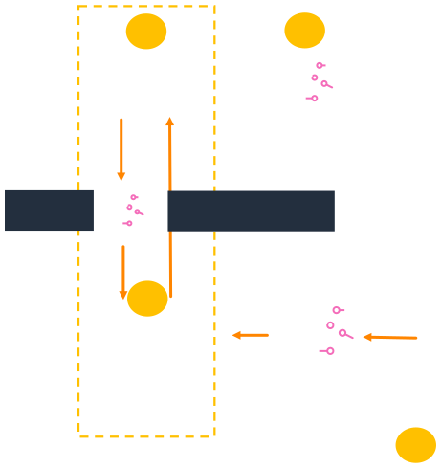
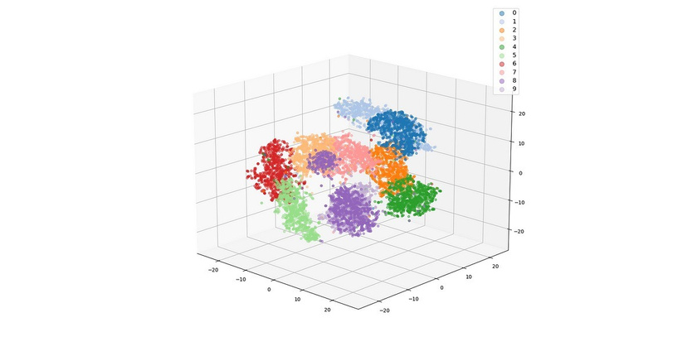



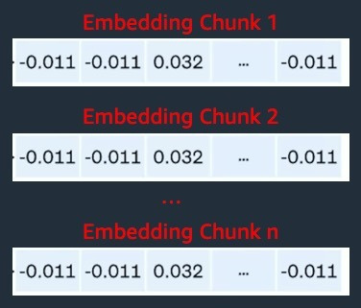



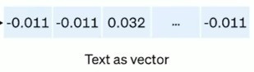
RAG architecture
1
3
Question + Context
LLM Endpoint
Answer
User
Embed the
Retrieve relevant documents as context
question
2
Knowledge
base
Vector DB
Document store
New/up
Embeddings
dated
Endpoint
docs
0
Notes:
13

Slide 22

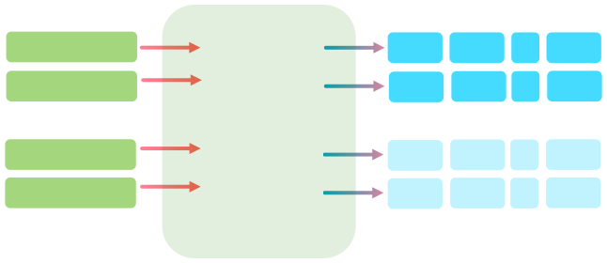
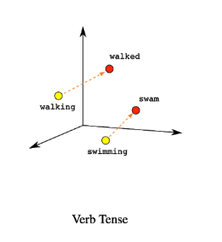
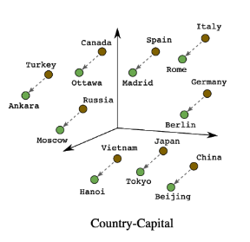




What are vector embeddings?
Source domain-
specific data
Tokenization
Vectorization
Store in vector data store
Perform semantic similarity search
Include semantically similar context in prompt
Documents
New York Paris
0.027
-0.011
…
-0.023
0.025
-0.009
…
-0.025
Animal Horse
EMBEDDING MODEL
-0.011
0.021
…
0.013
Audio/video
-0.009
0.019
…
0.015
Human Text
Vector Embedding
3D simplified representation. Embeddings can have thousands of dimensions. Source: https://daleonai.com/embeddings-explained
Images
Embeddings: when vector elements are semantic, used in generative AI
Notes:
Now, for those in the audience unfamiliar with semantic context and how that gets derived, here’s a short primer on vector embeddings.
You take your domain-specific data, and break it apart into elements that hold individual meaning in a process called tokenization.
The elements can be words, phrases, paragraphs, entire documents – whatever makes sense for your use case, such that you can have a set of meaningfully composable elements. You take the elements and pass them through an LLM to derive numerical vectors – essentially arrays of numbers for each element. These vectors place elements with related meaning close to each other in a multi-dimensional vector space.
Thus, finding meaningfully or semantically related data is reduced to mathematical functions of minimal distance between elements.
When you are using vector elements to represent meaning, in the context of generative AI, these are referred to as “embeddings”.
Words or information from this data can be represented in a multidimensional space where words or phrases with similar meaning or context can be grouped together. The distance between these words or neighbors can represent how close they are to each other in meaning or context. Here, we represent words in three dimensions.
An embedding is a numerical representation of content in a form that machines can process and understand. The essence of the process is to convert an object, such as an image or text, into a vector that encapsulates its semantic content. The distance between two embeddings indicates the semantic similarity between the corresponding concepts.
This distance estimation enables semantic search by..
Estimating similarities using distance.
(Semantic similarity vector search)
Similarity search involves finding data points that are most similar to a given query. Distance metrics, such as Euclidean distance or cosine similarity, quantify the similarity between vectors. These concepts are fundamental for tasks like recommendation systems, content similarity analysis, and anomaly detection in AI applications.
How do we leverage vector embedding and RAG? By using..
14

Slide 23








C
Model invocation with RAG
FM Endpoints
Amazon Bedrock
Amazon SageMaker
RAG
Vector Databases
MongoDB Atlas
Open Search Service
FAISS
Documents
Amazon S3
Amazon
EventBridge
Step Functions
Vector DB
Serverless Services
Native integration with Amazon S3
Orchestration with Step Functions
Question
Amazon
API Gateway
Amazon SQS
AWS Lambda
FM Endpoint
Use cases
Domain specific Q/A
Intelligent Document Processing
Text Summarization
15
Notes:
How do we add a RAG feature? We attach a new module !
In the new module, we see a clear workflow: User uploads a document to Amazon S3, An S3 upload event is received by Amazon EventBridge. Customers can write rules on what files need to trigger Step Functions workflow. The workflow then runs through multiple step to generate and store embedding in database.
With the RAG module attached, app user can then receive highly relevant answers asynchronously though websockets, IotCore topic or Appsync subscriptions and so on.
15

Slide 24
Demo RAG Use Case
Notes:
We would love to show you an E2E use case built on serverless.
33
Amazon Confidential

Slide 25



C’
Multi-Modal
Multi-modal Orchestrator
FM Endpoints
Amazon Bedrock
Amazon SageMaker
Vector Databases
Amazon S3
Amazon
EventBridge
Step Functions
Vector DB
MongoDB Atlas
multi-modal embedding
Serverless Services
Native integration with Amazon S3
Orchestration with Step Functions
Categorized Data
Use cases
Domain specific Q/A
Intelligent Document Processing
Text Summarization
Amazon Textract
Amazon Transcribe
Translation
16
Notes:
Serverless has rich & easy integrations with file systems, APIs, a variety of data sources. Rich integration with Domain Data.
Multi-modal is very often an integral part of RAG. When your input data are of different formats, e.g. PDF
16

Slide 26



D
Multiple Models
FM Endpoint
Amazon Bedrock
Amazon SageMaker Jumpstart
Models hosted on:
EKS
Other computes
Doc Summarization
Rule 1
Amazon SQS
AWS Lambda
Amazon Bedrock
Prompt Chaining
Serverless Services
Auth, Rate limiting, Caching with Amazon API Gateway
Amazon EventBridge or Amazon SNS to fan-out
Amazon SQS as subscribers
AWS Lambda or AWS Step Functions getting from the queue
ANTHROP\C
Rule 2
Amazon SQS
AWS Step
Functions
Amazon Bedrock
Amazon
API Gateway
Amazon
EventBridge
Image Generation
Use cases
Multi-model evaluation
Content generation from different models
Selecting model for specific task
Rule 3
Amazon SQS
AWS Fargate Task
Amazon SageMaker Jumpstart
17
Notes:
Very often, one model is not good enough. GenAI app is expected not just handle different types of input, but also calling different models to handle different tasks, based on function or cost considerations. Serverless architecture shows as a great fit in this case as it can quickly add rules to get new model working for the new task, all in one application. This change process only involves really light modification of codes, greatly shorten the change or development cycle. This is a great example to explain why serverless pairing with GenAI allows fast evolvement of your apps.
Lamnda for text
Prompt chaining with workflow
Image for Fargate.
Model evaluation
Quality and accuracy
So, we can ask geneiric questions and get answer from chatbot..
Some use cases require invoking multiple models. It could be generating content from multiple models for instance generating a marketing page require text as well as image content or evaluating response from multiple models.
Either case, Services such as Amazon EventBridge or SNS can help with event routing. Rules on the EventBridge event bus or SNS can be written to invoke all three models or one or more depending on the requirements.
On the consumer side, customer’s can easily plug in services such as Lambda, Fargate or Step Functions to complete the processing. Just like with other patterns, Rich integration, extensibility are the key to use Serverless services for this one as well.
17

Slide 27





Workflow automation challenges
Human agents stretched, need productivity tools
LLM’s are powerful,
but they can’t
take actions
Integration of databases and systems is
expensive and slow
Building production agents involves complex engineering
Need diverse set of programming languages and interfaces
20
Notes:
Question: Please raise your hand if you developed GenAI application and faced any of those problems?
20

Slide 28
Slide is animated
What does the future hold for generative AI?
Notes:
The entire space is moving at such a rapid pace, it can be difficult to predicting what and when something is coming out next. But when it comes to solutions being developed by our customers, we’ve seen a few key trends that will become more and more important in the near future.
Agents – First off, is Agents. As the complexity of tools and applications continue to grow, we’ve seen the rise in use of Agents to perform more complex tasks. In just a few clicks, agents can orchestrate and analyze tasks and break it down into the correct logical sequence, and call the necessary APIs to transact with the company systems, and determine requirements for next steps. This is the start to truly exciting future where we have end-to-end workflow automation.
Multi-modality – While large language models get the most press right now, increased adoption of agents and complexity of solutions will highlight the need for multi-modal data and models. Having the ability to accept ANY (and multiple) data input types – allows customers to merge structured tabular data, audio recordings, video, and unstructured text. This will allow users to more easily and effectively communicate intent and supporting data to the foundation models, and over time we expect to be able to input any type of data and generate any output data type we want. This ties back in with Agents, and is a step to unlocking assistants and end-to-end workflow automation with any data type and any interface.
Multiple models– Another key trend we’ve seen is the use of multiple models from our customers. As they put complex solutions into production, the need to optimize on speed, price, and accuracy, is important. Our customers are finding that they can do this by using different types of models for different tasks. Some models are better with multiple languages, some better for summarization, and others are cheaper to run their inference. And it comes down to model specialization - specialized models developed for the best-in-class output quality for whatever that task needs completed. Things like fine-tuning and model grounding will play a role her as customers use these models with knowledge from their organization. Every customer – and their use cases – will have different preference levels for their speed, accuracy, and cost characteristics, meaning there will be a huge demand for a wide breadth of different models. Flexibility is key as you scale.
Regulations – While it’s not here yet, we know there will be regulations coming to this space, and we know they will likely involve security of these systems and their ethical use. We’re committed to developing and deploying AI and other machine learning services responsibly, and we believe that regulation should require others to do the same. Our commitment to safe, transparent, and responsible generative AI also includes collaboration with the global community and policymakers to share best practices, and we encouraged and supported both the White House Voluntary AI commitments and the AI Safety Summit in the UK. We encourage policymakers around the globe to collaborate with industry to support the safe, secure, and responsible development of AI technology.
8

Slide 29

Features
Agents for
Amazon Bedrock
Uses power of LLM’s to prompt and respond using natural language
Breaks down and orchestrates tasks
Completes tasks by dynamically invoking APIs
Securely and privately accesses company data
Surfaces chain-of-thought trace and underlying agent prompts
Enable generative AI applications
to execute multi-step business tasks
using natural language
Generally available
21
Notes:
Natural Language Instruction
Breakdown to tasks
Invoke API
Security
21

Slide 30



Agent basics
Agent
I need to take a vacation from 25ⁿᵈ to 30ᵗʰ Dec 2025.
Instructions: “you are an agent that …”
Done. Here’s the result…
Actions
Knowledge Bases
Amazon Bedrock
22
Notes:
Instructions
Actions
Knowledge bases
Amazon Bedrock
22

Slide 31
Agents use actions to get work done
AI Agent assistant
list the available resort room
Instructions: “Help customer, guidance booking Hotel...”
Here are results after
real-time searching
Searching Actions
Utility Actions
List Rooms
In: date checkin.
Out: [date, roomAvailable, amount]
Query KB
In: amenitions, accommodations
Out: [response info]
Do you want to book?
Guide me the way to booking
Sure, please provide ...
23
Notes:
23

Slide 32
Agents use Knowledge Bases to find information
Hotel Reception Assistant
Instructions: “you are an Hotel agent, helping customer booking following Allowance Hotel”
Can I pay the rent later ?
HR Knowledge Base
Hotel Policy
Contains the entire customer policy for the Hotel/Resort
Sorry, you need to checkout the payment before rent.
24
Notes:
24

Slide 33
Agents can combine Actions and Knowledge Bases
Hotel Reception Assistant
What types of rooms does the hotel have?
Instructions: “you are an Hotel agent, helping customer booking following Allowance Hotel, provide guidance to booking room”
Sea View, Mountain View,
Kingdom Type
Hotel Policy
Contains the entire hotel policy for the customer
Customer Information
In: date, name, phone
Out: bookingId confirmed
cool. I’d like to booking Sea View on December 10-15th
booking confirm, enjoy.
Reception Knowledge Base
Reception Actions
25
Notes:
25

Slide 34




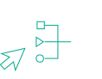
Agent orchestration – Detailed flow
PROMPT
Conversation history
Actions, KBs
Instructions
Task
Step 1
Step 2
…
Step n
Chain of thought
API call
Results
Action
Groups
Bedrock
model
Task
Bedrock
Agent
Results
Search
Results
Knowledge
Bases
Task + results
Final response
Final response
Bedrock
model
Agent breaks task into subtasks, determines the right sequence,
and executes actions and knowledge searches on the fly
© 2024, Amazon Web Services, Inc. or its affiliates. All rights reserved. Amazon Confidential and Trademark.
26
Notes:
26

Slide 35

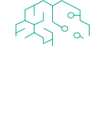


Agents enterprise resources on AWS Architecture
Tool & Action
Backend
Hotel knowledge base
Bedrock Agent
search-Hotel Info-policy
Hotel Resources Detail
Hotel resources docs
Searching actions
get-Rooms-Availability
Reception Booking Agent
Room Availability Action Group
Room Availability Table
Guardrails
room booking
Hotel Booking actions
Room Booking Action Group
Booking Table
Amazon Simple Email Service
Short & Long Term Memory
Notes:
Agent breaks task into subtasks, determines the right sequence, and executes actions and knowledge searches on the fly
27

Slide 36
Demo Agent
Notes:
We would love to show you an E2E use case built on serverless.
33
Amazon Confidential

Slide 37

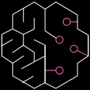
Agents
101010..1
101010..1
101010..1
101010..1
101010..1
101010..1
In-memory/vector database
Persistent Datastore
OpenSearch / Kendra / PostgreSQL
Memory
Action
Math
Calcs
Agent
Simulation
Tools
Plan
Search
API
Agents
Autonomous
Action
Amazon
Bedrock (LLM)
Notes:
Agents là 1 kĩ thuật chúng ta định nghĩ các tool, từ các tool đó cho phép LLM lựa chọn tool thực thi prompt truyền vào
Ví dụ lựa chọn search, tính toán. Từ đó phân tích prompt và đưa action phù hợp.
The core idea of agents is to use a language model to choose a sequence of actions to take. In chains, a sequence of actions is hardcoded (in code). In agents, a language model is used as a reasoning engine to determine which actions to take and in which order.
28

Slide 38


Multi Agent
System Prompt
Plan a travel to Chengdu, including flight and hotel.
Hotel Agent
ReAct or Workflow
LLM Claude3 Haiku
Tools
Agent Orchestration
ReAct or Plan
System Prompt
Flight Agent
ReAct or Workflow
LLM Claude3 Sonnet
Tools

Slide 39
How to get started?
Notes:
38
Amazon Confidential

Slide 40

Start your GenAI Journey with AWS First Cloud Journey
https://github.com/aws-samples/AWS-First-GenAI-Journey

Slide 41


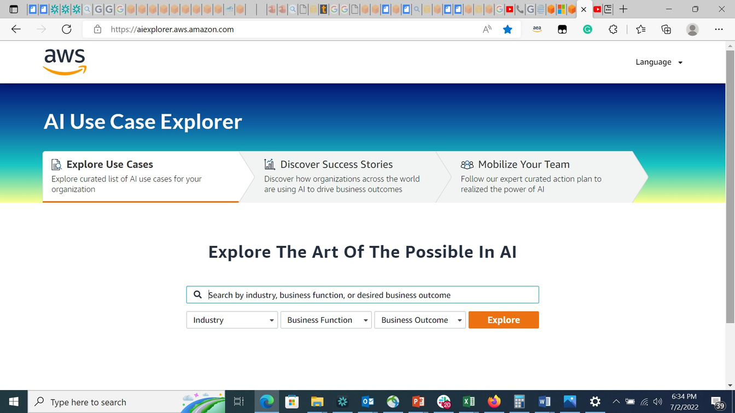
AI Use Case Explorer
Easily find the most relevant AI use cases with related content and guidance to make them real
aiexplorer.aws.amazon.com

Slide 42




Start your Serverless Gen AI journey today
Check out the
generative AI
webpage
Read announcement blog post
Watch Werner Vogels, AWS VP and CTO, explain generative AI
Check out Serverless patterns for your GenAI application
40
Notes:
Generative AI web page - https://aws.amazon.com/generative-ai/
Announcement blog post- https://aws.amazon.com/blogs/machine-learning/announcing-new-tools-for-building-with-generative-ai-on-aws/
Werner video - https://youtu.be/dBzCGcwYCJo
40

Slide 43

Thank you!
Thuan Phat - LinkedIn: https://www.linkedin.com/in/tienthuanphat/
Software Engineer
@Katalon
© 2024, Amazon Web Services, Inc. or its affiliates. All rights reserved. Amazon Confidential and Trademark.

